Slide 1
Travel Planner agent
CAPSTONE PROJECT
Presented By: Bitan Kumar Ghosh
Student name : Bitan Kumar Ghosh
College Name & Department : Institute of Engineering & Management Kolkata, Electronics and Electrical Engineering

Slide 2
OUTLINE
Problem Statement
Technology used
Wow factor
End users
Result
Conclusion
Git-hub Link
Future scope
IBM Certifications

Slide 3
Problem Statement
Travelers, tourists, and business professionals face a fragmented and overwhelming process when planning trips. Manually navigating numerous websites, comparing endless options for flights and hotels, and managing separate bookings across different platforms is complex, stressful, and highly time consuming.
Proposed Solution: An AI-powered Travel Planner Agent, utilizing IBM Cloud for real-time data integration and IBM's Granite model for advanced personalization, to assist users by suggesting tailored destinations, building optimized itineraries, and recommending ideal transport and accommodation. The agent will also manage bookings and dynamically adapt plans based on real-time alerts for weather, traffic, or schedule changes.

Slide 4
Technology used
IBM cloud lite services
Natural Language Processing (NLP)
Retrieval Augmented Generation (RAG)
IBM Granite model

Slide 5
IBM cloud services used
IBM Cloud Watsonx AI Studio
IBM Cloud Watsonx AI runtime
IBM Cloud Agent Lab
IBM Granite foundation model

Slide 6
Wow factors
This agent will significantly reduce travel planning time from days to mere minutes, eliminate the stress of managing multiple bookings, and elevate the quality of travel experiences. It empowers travelers to discover unique destinations and build perfectly tailored trips, transforming a complex process into a seamless, enjoyable, and truly personalized journey.
Unique features:
Dynamic Itinerary Generation: Creates bespoke travel plans based on nuanced user preferences, budget, interests, and travel style, not just simple filters.
Real-time Itinerary Optimization: Autonomously adjusts schedules in response to flight delays, adverse weather, or traffic, sending instant alerts and alternative suggestions.
Unified Travel Hub: A single dashboard to manage all flights, hotel confirmations, car rentals, and event tickets, eliminating the need for multiple apps and emails.
Context-Aware Recommendations: Suggests hidden gems, local events, and restaurants that align with the user's profile and real-time location during the trip.
Smart Budget Tracking: Provides real-time cost analysis and forecasting to ensure the trip stays within budget, with alerts for potential overspending.

Slide 7
End users
Leisure & Family Travelers
Business & Corporate Professionals
Group Coordinators & Event Planners
Solo, Backpacker, and Budget-Conscious Travelers
Travel Agencies & Tour Operators

Slide 8
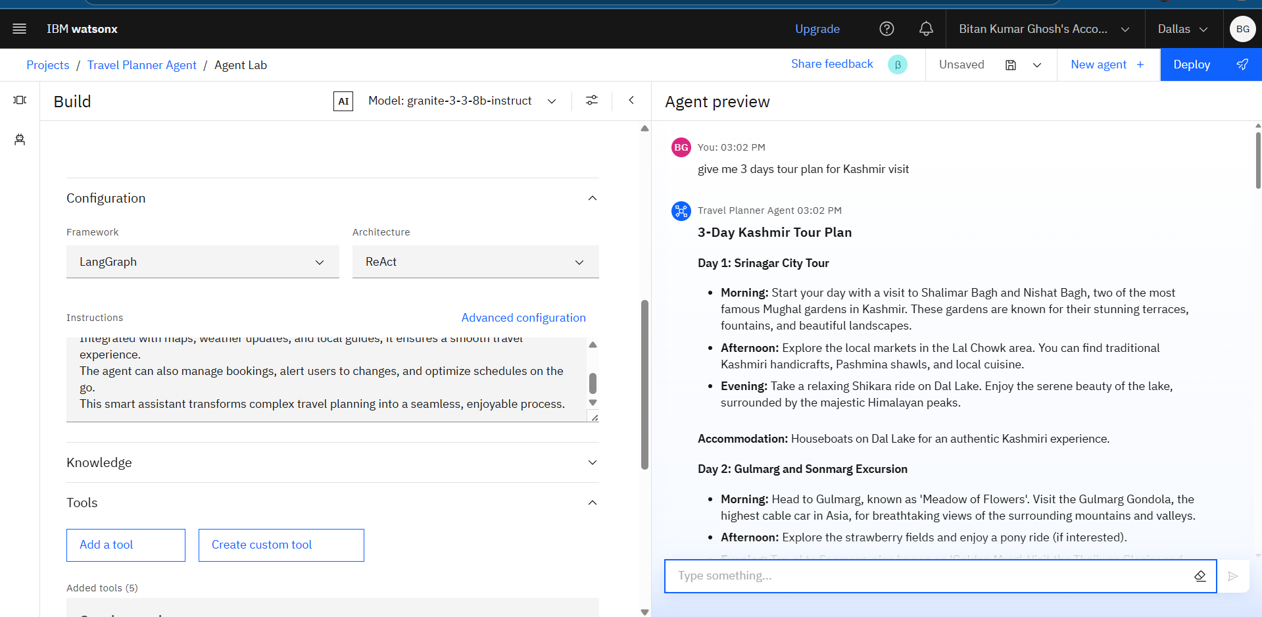
Results

Slide 9
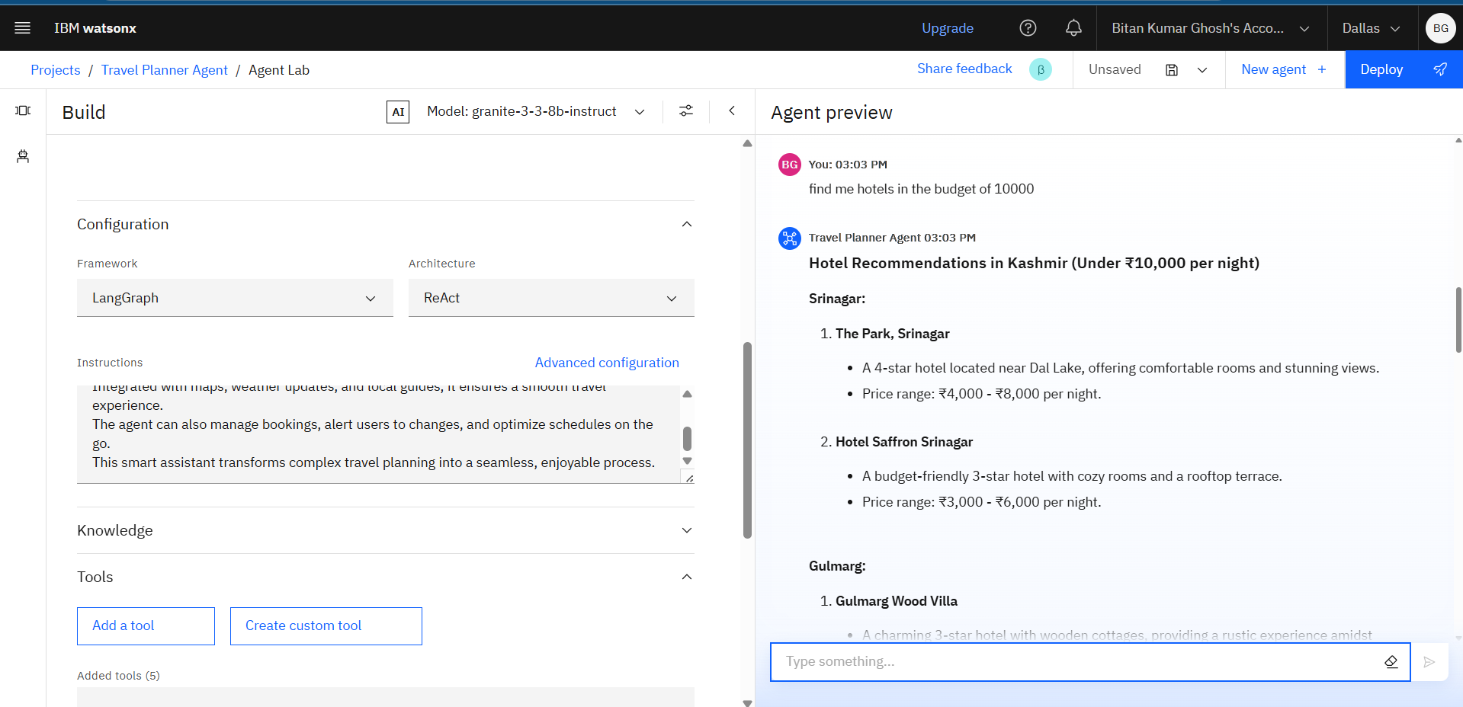
Results

Slide 10
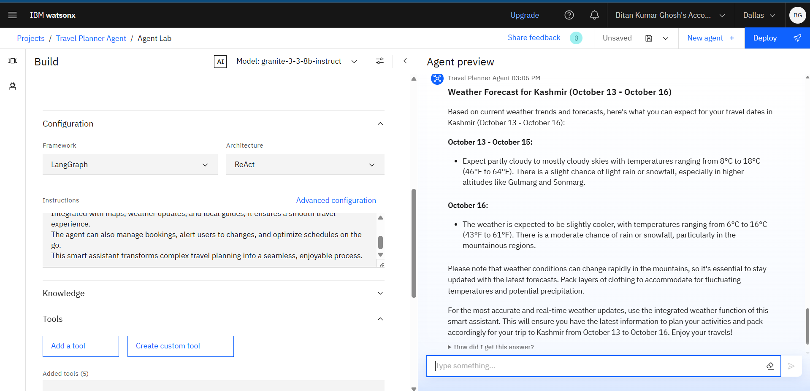
Results

Slide 11
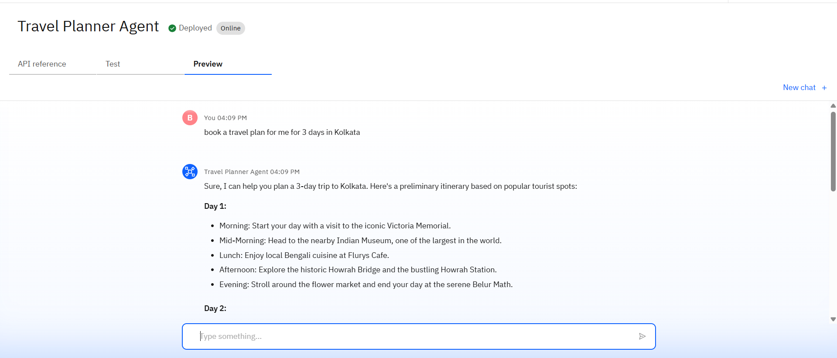
Results
Deployed AI Agent

Slide 12
Conclusion
The agent can design complete, personalized itineraries, manage all bookings and tickets in a single hub, and even reroute plans based on live data.
It saves users hours of planning time by automating the tedious tasks of price comparison, option filtering, and schedule coordination.
Ultimately, the AI Travel Planner enhances the entire travel lifecycle, making trips more efficient, personalized, and enjoyable from the initial idea to the journey home.

Slide 13
Future scope
Allowing multiple users to edit, comment on, and build an itinerary together in real-time.
Enabling users to manage their plans and ask for suggestions hands-free while on the go.
Suggesting activities or deals based on anticipating user needs (e.g., "Your favorite artist is playing in London during your trip").
To automatically track spending against a budget and simplify splitting costs among travel companions.
Allowing users to virtually explore hotels, attractions, or restaurant interiors through their smartphone.

Slide 14
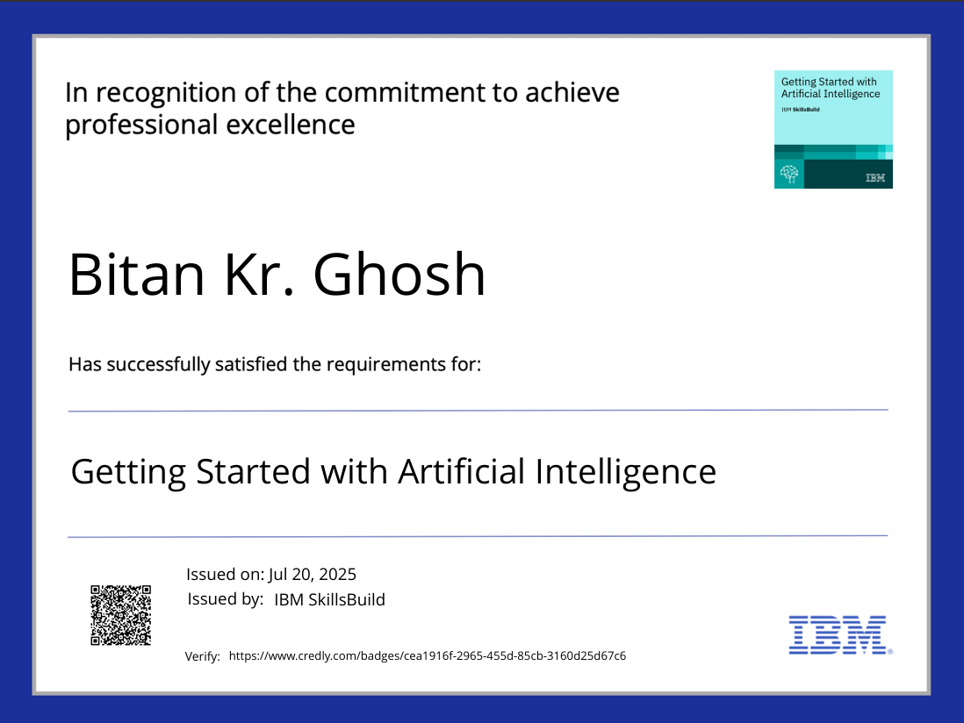
IBM Certifications

Slide 15
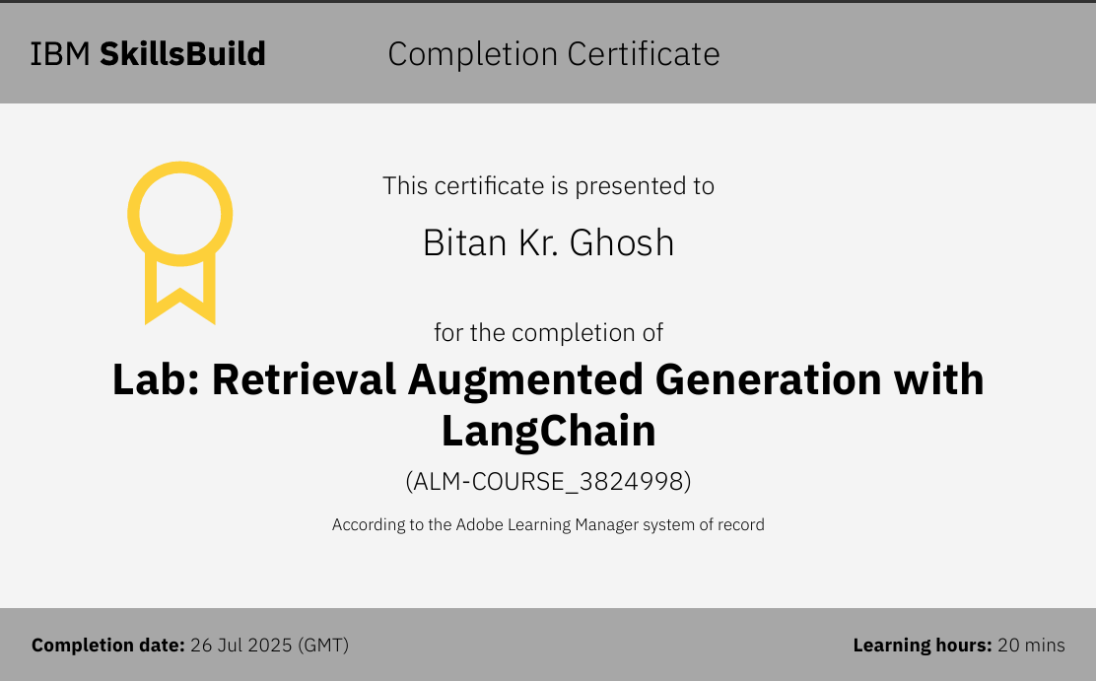

Slide 16
Git hub link : https://github.com/BitanGh/Travel-Planner-Agent

Slide 17
THANK YOU

